Slide 1

OLIST STORE ANALYSIS
Group -3

Slide 2

Agenda
Overview
Connection
KPI
Dashboard
Conclusion

Slide 3
Overview
The Olist Store Analysis project aims to analyze customer purchasing patterns and payment statistics on an Ecommerce platform, Olist.
This project covers several key performance indicators (KPIs) such as weekday vs weekend sales, payment statistics, delivery time, and customer behavior.
The analysis is based on nine CSV files, which are cleaned and manipulated to extract valuable insights.

Slide 4

Connection

Slide 5
KPI
Weekday Vs Weekend - Payment StatisticsWeekday Vs Weekend (order_purchase_timestamp) Payment Statistics
Number of Orders with review score 5 and payment type as credit card.
Average number of days taken for order_delivered_customer_date for pet_shop
Average price and payment values from customers of sao paulo city
Relationship between shipping days (order_delivered_customer_date - order_purchase_timestamp) Vs review scores.

Slide 6
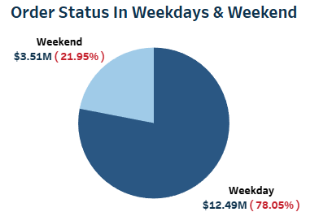
KPI - 1
Weekday Vs Weekend - Payment Statistics
The analysis of payment statistics based on weekday vs. weekend provides an understanding of the buying behavior of customers.
The analysis of this KPI can help Olist to improve their weekend sales and plan promotions accordingly

Slide 7
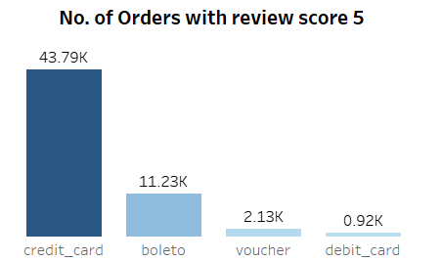
KPI - 2
Payment Type with review score 5
This KPI analyses the number of orders with a review score of 5 and payment type as credit card.
This helps in understanding customer satisfaction levels and payment preferences.
Olist can use this information to identify satisfied customers and encourage them to make repeat purchases

Slide 8
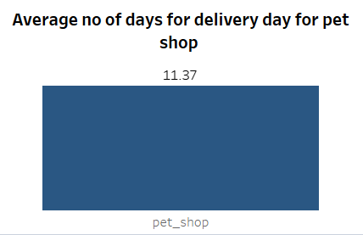
KPI - 3
Average number of days taken for pet shop
This KPI analyzes the average number of days taken for delivery day for pet shop.
It helps Olist in identifying areas where they can improve their delivery time and maintain customer satisfaction.

Slide 9
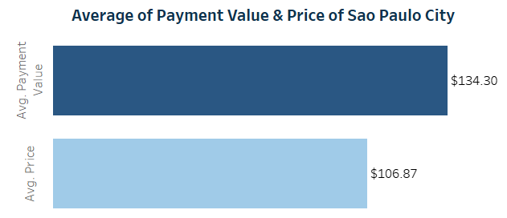
KPI - 4
Average price and payment value of sao paulo city
The analysis of average price and payment values from customers of Sao Paulo city helps in understanding the spending patterns of customers in this region.
It also helps Olist in identifying high-value customers and creating targeted marketing campaigns.

Slide 10
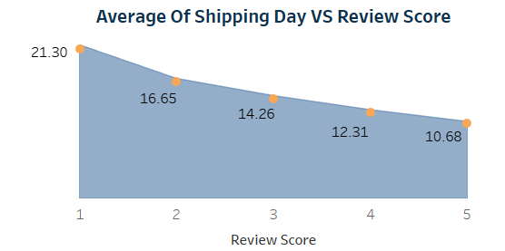
KPI - 5
Average shipping days vs review scores
This KPI analyzes the relationship between shipping days and review scores.
It helps in understanding the impact of delivery time on customer satisfaction levels.
Olist can use this information to optimize their logistics and improve their delivery time.

Slide 11
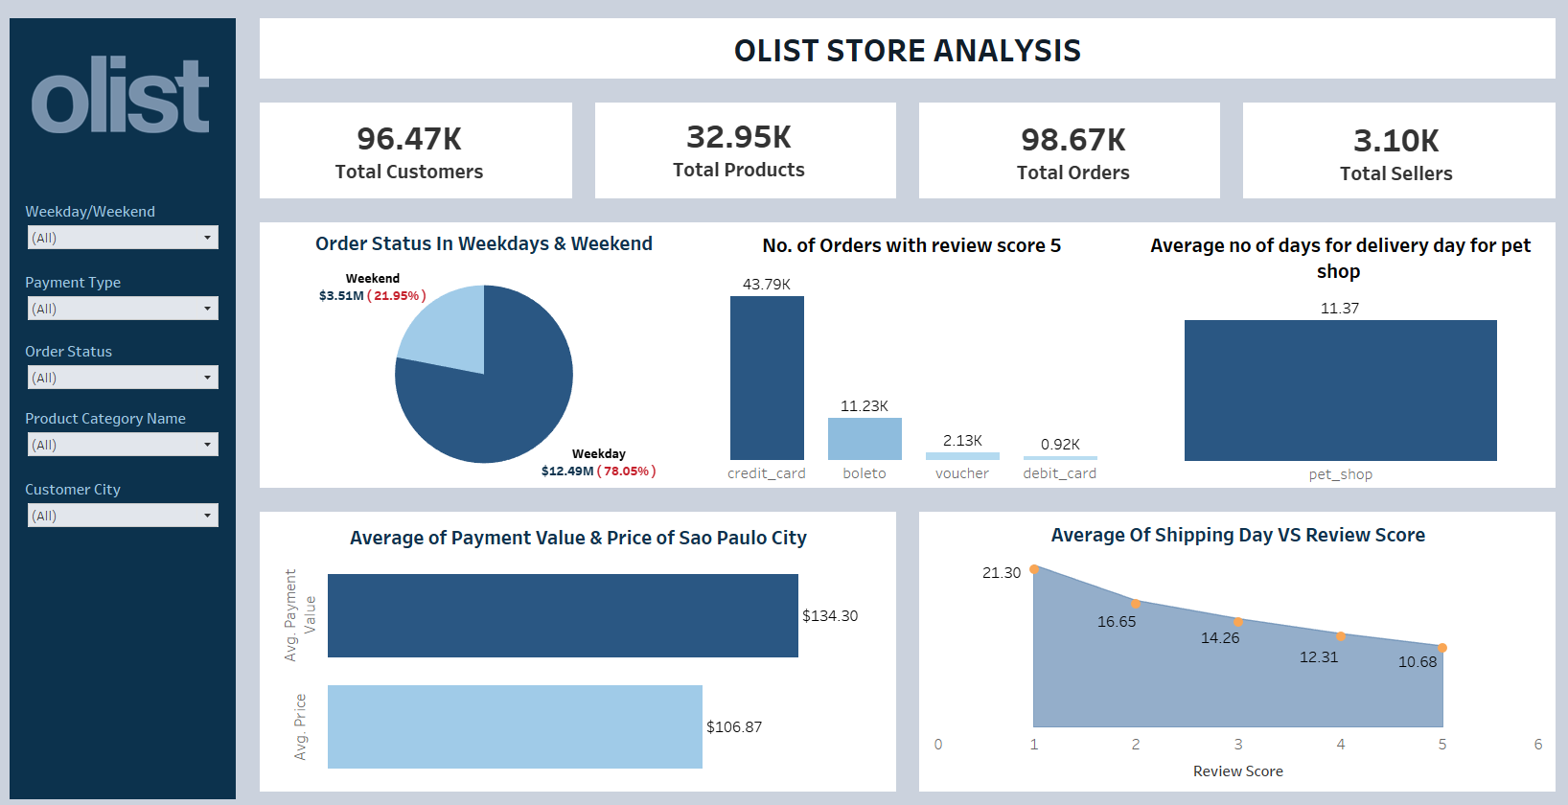
Dashboard

Slide 12
Conclusion
The Olist Store Analysis project highlights the significance of understanding customer behavior and payment statistics for targeted marketing.
By utilizing Excel and Tableau for data cleaning and visualization, the analysis reveals actionable insights for improvement.
Ultimately, this project showcases how data analysis empowers businesses to make informed decisions and enhance overall performance.

Slide 13
Thank you

